Slide 1
Introducing 3D Properties and Building Digital Customer Processes
Pekka Halme
Director of Strategic Development
Aaro Mikkola
Development Manager
PCC Conference
Riga
May 13, 2015

Slide 2
Contents
3D Properties
  Background
  Assignment from MAF
  Main issues
  Conclusion
Digital Customer Processes
  Current and planned services
  Planned functionalities
  Possibilities and challenges

Slide 3
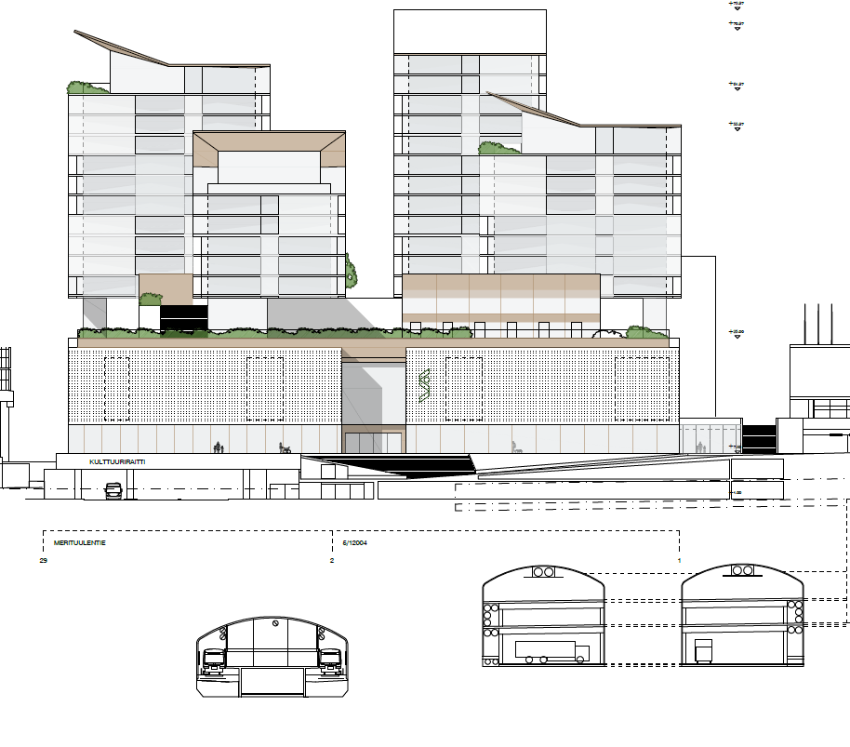

Slide 4
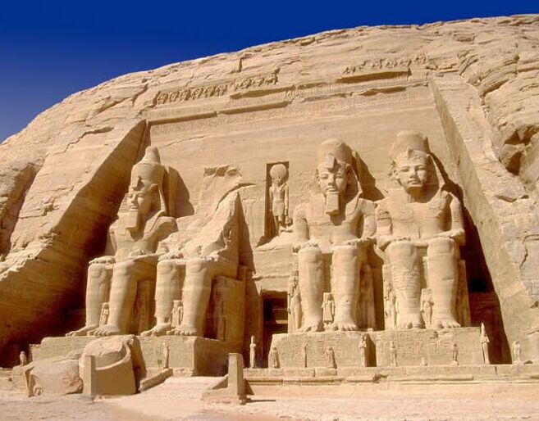
Background
  Proposal from municipal cadastral engineers’ association in 2005
  MAF working group report 2008
  MAF assigned studies to clarify the starting point
    Judicial study 2011
    Technical and functional study 2012 (NLS)
  Specification project 2013-2014 (NLS)

Slide 5

Starting Points
  MAF Assignment Oct 16, 2012
  Current system the main rule
  Prerequisites for 3D property formation stated in the city plan
  Dimensions of 3D property defined by XYZ coordinates
  Boundaries of 3D property do not have to coincide with those of existing 2D properties
  Only one 3D property allowed above 2D property
  Buildings or their parts cannot be formed into 3D properties

Slide 6

Project (3DIESEL/mä)
  NLS carried out the assignment as a project
  Project group members from NLS, and three cities
  Discussions with several stakeholders
  Project ended on January 14, 2015
  Goal to reach capability for roll-out by the end of 2016

Slide 7

Stakeholder Discussions*
  Meeting with the building supervision representatives of the ten biggest cities
  Training event of the Finnish Lawyers’ Association
  Ministry of Environment
  Mr. Haataja, consultant (building projects)
  RAKLI (Association of real property owners, investors, contractors etc.)
  City of Helsinki, town planners etc.
  Federation of Finnish Financial Services
  City of Espoo, town planners and project managers
  IT system providers

Slide 8

Main Issues
  Number of 3D layers
  Division of buildings or their parts into 3D properties
    MAF gave up the prerequisite
  City plan as basis for 3D property formation
    How to instruct the planners (MoE)
  Plot division
  Property formation (cadastral survey)
  Servitudes (right of way, access,…)
  Collaterals/securities

Slide 9
Schematic Picture
3D
3D
2D property
3D
3D

Slide 10


91-4-64-15
  2D property on the ground
  3D layers:
    Below:
      91-4-64-101 (3D property below ground)
      91-4-64-102 (3D property below ground)
      91-4-64-103 (3D property below ground)
    Above:
      91-4-64-105 (3D property above ground)
91-4-64-104
(3D: above ground)
91-4-64-105
(3D: above ground)
91-4-64-15 (2D: on the ground)
91-4-64-24 (2D: on the ground)
91-4-64-102
(3D: below ground)
2D property on the ground
91-4-64-101
(3D: below ground)
91-4-64-103
(3D: below ground)

Slide 11
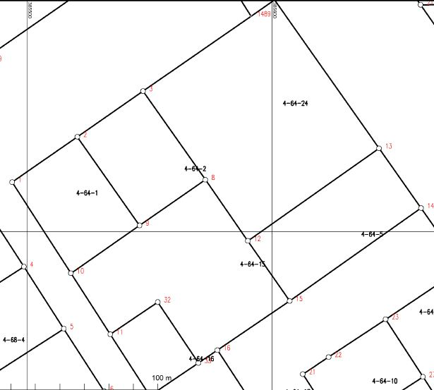
Properties Projected on Map
Below ground
Above ground
On the ground
4-64-103
4-64-101
4-64-104
4-64-105
4-64-102

Slide 12

Simplified Process*
  Project plan
  City plan
    Height of land use in meters or levels
  Plot division
    Defines the new (3D) planned properties
    Dimensions
    Realization agreement at this stage
    Access in the agreement at the least
  Subdivision
    Right of access based on realization agreement
  Building permit
    Comprises all necessary conditions
    Use rights mainly through a separate decision
  Realization of project

Slide 13

Project’s Proposals
  Traditional 2D properties cover whole country independent of new 3D properties
  3D properties can only be formed in city planned areas
    Avoid speculative property formation
  Number of 3D property layers not limited
  Buildings and their parts can be formed into 3D properties according to city plan
  In Cadaster about each unit e.g.:
    3D feature
    Properties above and below
    Max and min height level (exact dimensions in the surveying documents)
    Projection on the index map

Slide 14

Situation today
  Project report to MAF
    January 14, 2015
  Goal to reach readiness for roll-out by the end of 2016
  MAF
    Responsible for necessary legislative preparation
  NLS
    Two projects (implementation, realization)
      Representatives from municipalities and their association
      IT system changes
      Cooperation with municipalities, necessary training etc.

Slide 15

Conclusion
  Challenges in specification
      World above ground i.e. buildings
      Content of city plans
  Updating of the municipal IT systems
      funding model in particular requires discussion
  → Cooperation between municipalities, construction project stakeholders and the NLS important

Slide 16
Contents
3D Properties
  Background
  Assignment from MAF
  Main issues
  Conclusion
Digital Customer Processes
  Current and planned services
  Planned functionalities
  Possibilities and challenges

Slide 17
NLS current customer services
Personal ”Deskservice”
Interactive
”Self service”
Information delivery
”One-way service”
NLS Web pages
Web-pages
& Social Media
Facebook
Twitter
LinkedIn
YouTube
Local service points
Call center
Property
Transaction
Service
Discovery service: GIS metadata Catalogue
Map interfaces
WMS / WMTS / WFS
Content services
Open data
Data by order

Slide 18
NLS services
2017
Personal ”Deskservice”
Interactive
”Two-way services”
Information delivery
”One-way service”
Web-pages
& Social Media
Interactive web services connected to NLS core prosesses
Local service points
Call center
Connection to national Service Architecture gateway
Content services
Videocontacts
New ticketing system
Extranet for joint projects
INSPIRE services
Transformation
Visualisation
Property
Transaction
Service

Slide 19
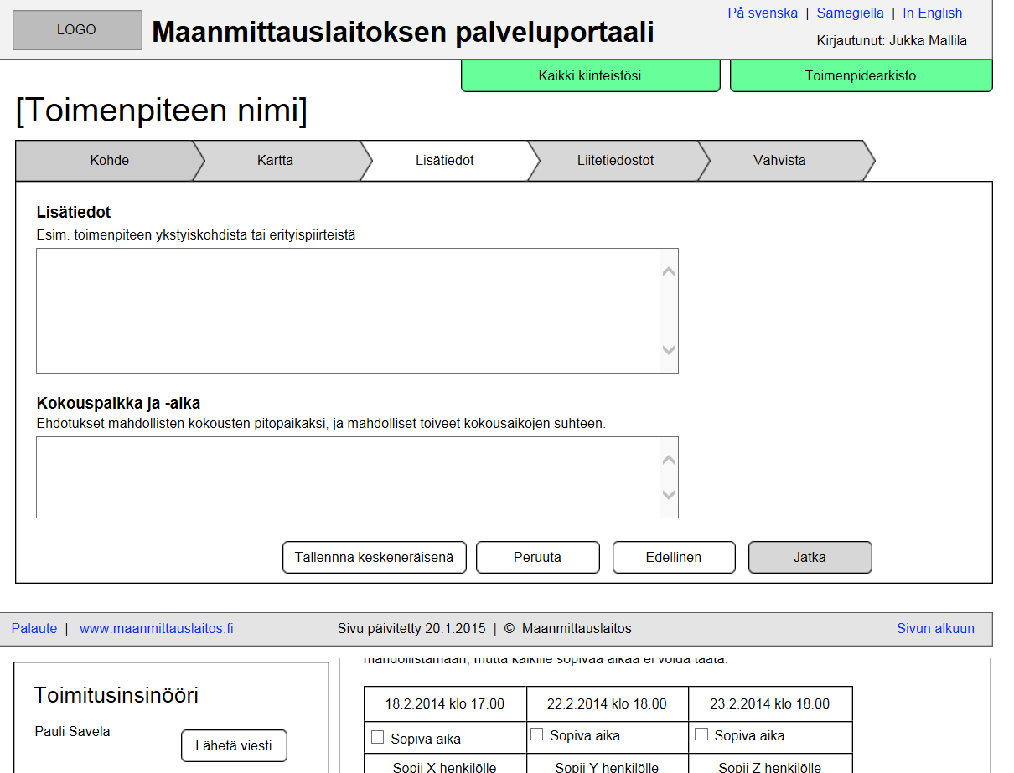
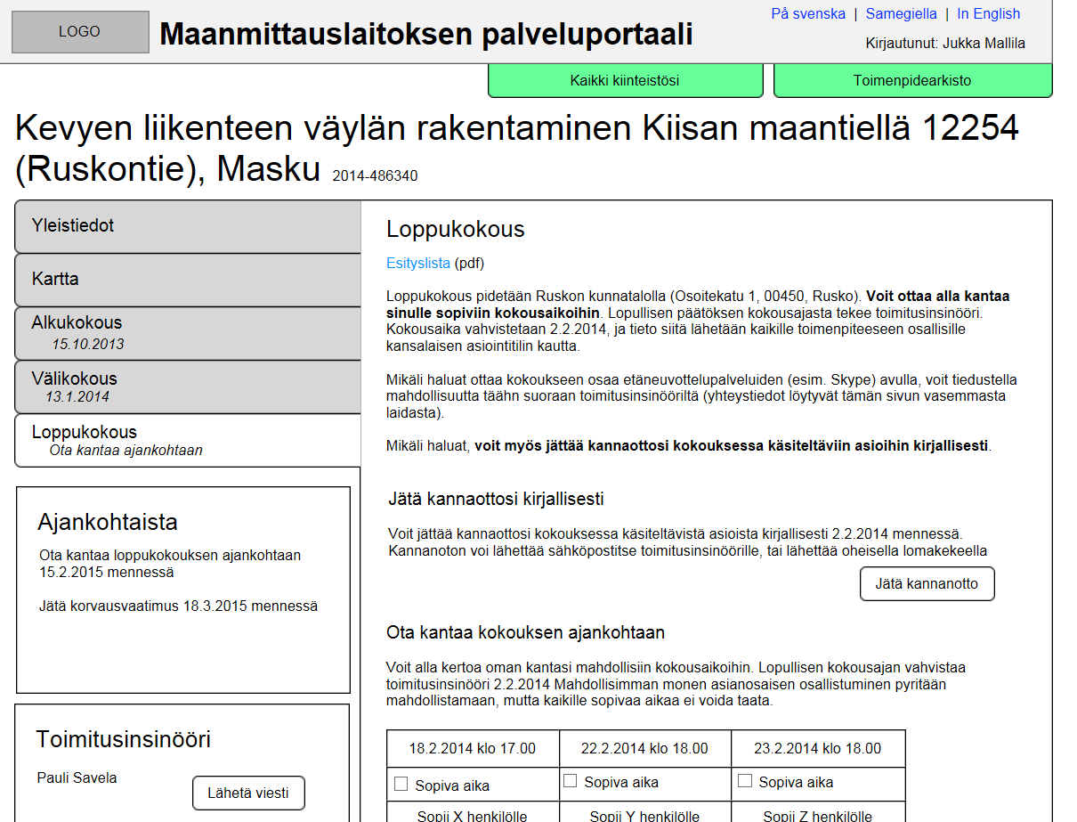
What can you do with the Two-way services ?
Initiate cadastral survey operations:
  Guidance on web pages with service descriptions and videos
  Map interface connected with forms (application etc.)
  Estimated timetable and costs
Take part in cadastral surveys via web
  See all the phases: memos, maps and other material
  Give comments, make questions
  Propose date and time for next meetings

Slide 20
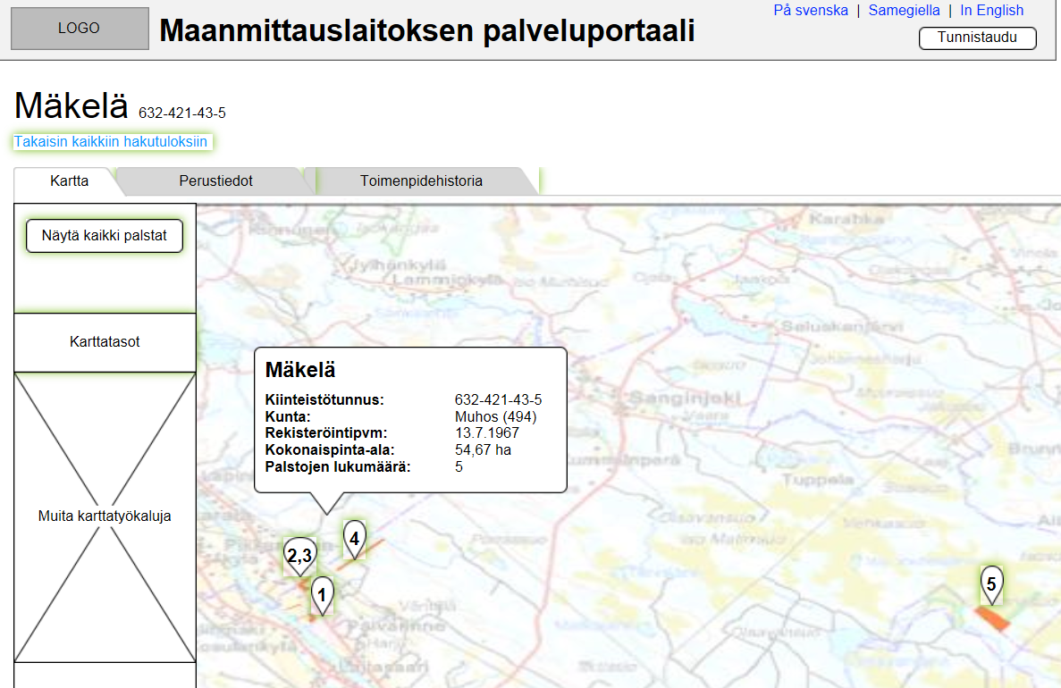
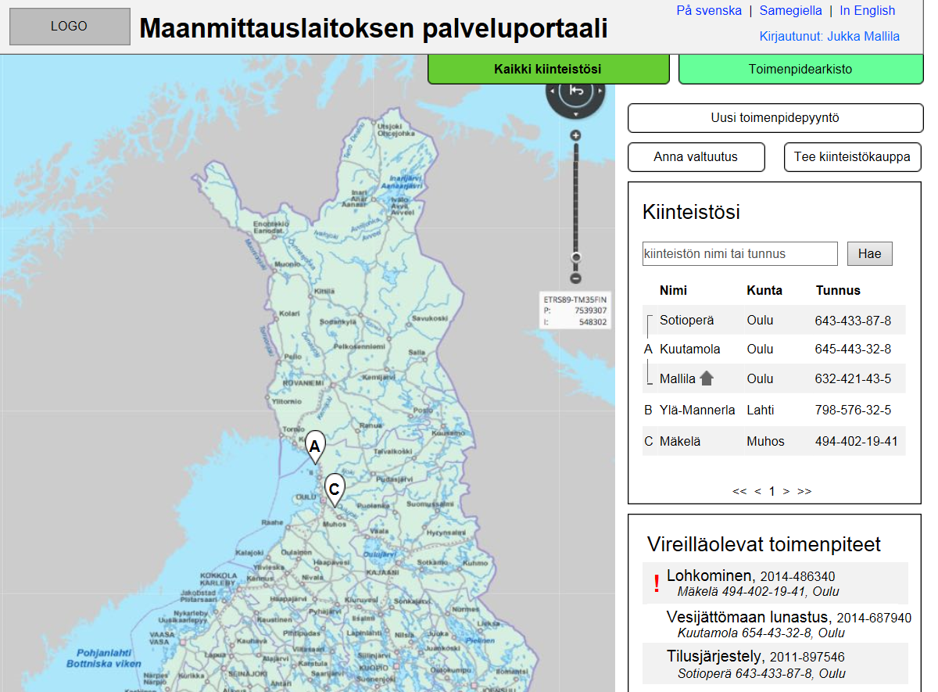
What can you do with the Two-way services ?
Search objects by:
  Real property ID, place name, address
Download free:
  Topographic and historical maps, aerial and laser scanned data
Order NLS products:
  Registry certificates, printed maps...
Check basic information of own real properties
Get access to archive material
See all current activities
See personal transaction history
Create authorizations for others (to act in your place)

Slide 21
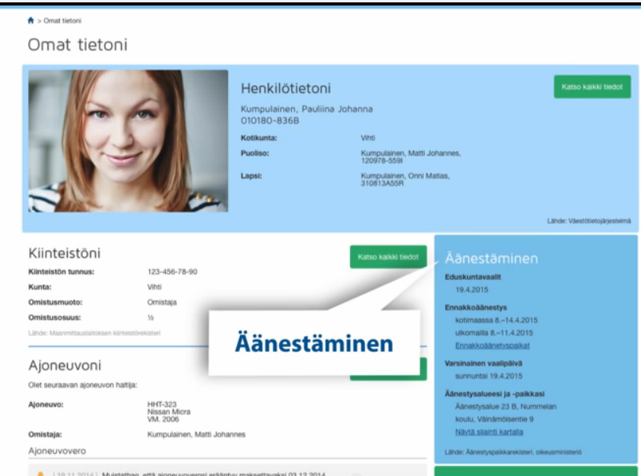
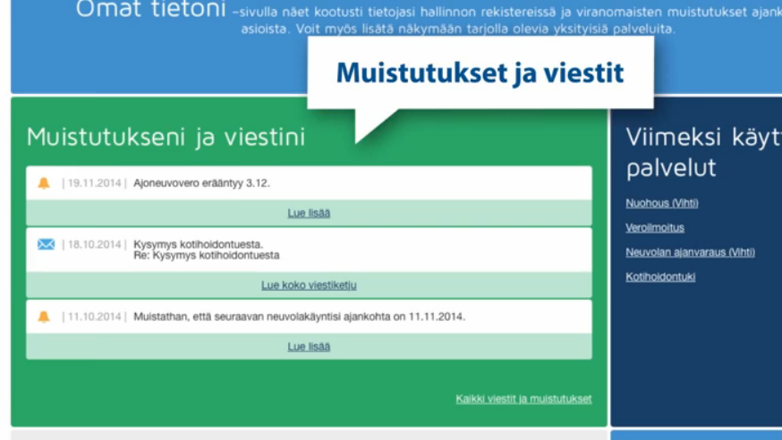
Connection to national Service Architecture gateway

Slide 22
Possibilities and Challenges
Get real connection between our core processes and web services
Make it easy and understandable in the web → Activate land owners to initiate legal surveys and cadastral operations
Decrease customers’ own costs of participating in legal surveys
Increase productivity of NLS core processes
How to manage the technical challenges?
How to get users to the web services when land owners take part of these activities possibly ”once in a lifetime”?

Slide 23
More information
pekka.halme@maanmittauslaitos.fi
aaro.mikkola@maanmittauslaitos.fi

